Slide 1

Research is the Foundation for Successful Advocacy
Presented by: Cheryl Vines & Lisa Elijah

Slide 2
Welcome & Webinar Process
Today’s webinar will be recorded and available for viewing on PVA.org​
Closed Captioning is available. Click the CC button in the meeting controls bar at the bottom of your screen to turn it on.​
If you have a question, please type it in the Q&A box. Questions will be answered at the end of the program.

Slide 3
Introductions
Cheryl Vines– Director of Research and Education
Lisa Elijah– Grassroots Advocacy Manager, Retired Air Force, PVA member

Slide 4
Research & Education
Funds Research & Educational grants
Creates Clinical Practice Guidelines
Conducts a Healthcare Provider Summit
Develops Resources and Support for SCI, MS, & ALS Care
Support University Based Research in SCI, MS & ALS

Slide 5
Government Relations
Policy Priorities
Yearly Legislative Summit
Grassroots Advocacy
Chapter Government Relations Support

Slide 6
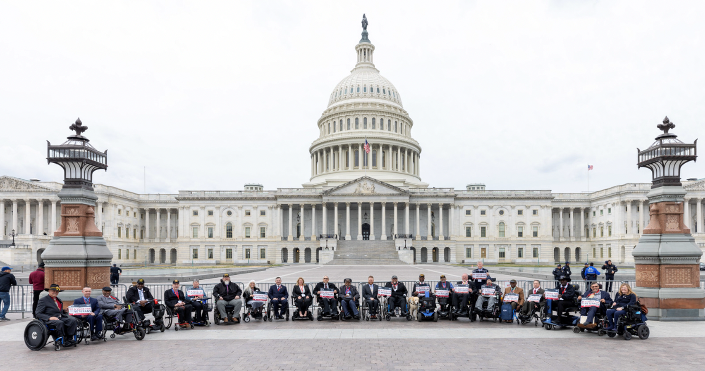
Importance of Research

Slide 7
What is important to those who live with SCI/D?
Over 30% of respondents wanted to be both more active in, and learn more about, research advocacy.

Slide 8
Nothing About Us Without Us!
“Nothing About Us Without Us!” (Latin: “Nihil de nobis, sine nobis”) is a slogan used to communicate the idea that no policy should be decided by any representative without the full and direct participation of members the group(s) affected by that policy.
Legislation
Social Services
RESEARCH

Slide 9
Why do we need research advocates?
In the past, research has often been done without input from the end user on the research question, process, or outcomes. This can result in the product or result from the research being abandoned, as it it is not actually helpful to the person that it is targeting.
Other communities have had great success in using research advocates to move research forward in an inclusive manner, such as certain pediatric genetic disorders, cancer, and Parkinson’s disease.

Slide 10
What is a research advocate?
Research Advocates…..
  collaborate with researchers and research institutions to make research more useful for the SCI/D community.
  provide researchers with the perspective of the SCI/D community and help researchers to focus on the questions and issues that are most important to the community.
  ensure that quality of life for the community is kept at the forefront of research projects.
There are many ways to be involved in research as an advocate. A research advocate can work directly with the scientific community or be a bridge between researchers and those who live with SCI/D.
Research advocacy is not one size fits all.

Slide 11
Who can be an advocate?
Anyone with lived experience can be a research advocate.
You do not need to have a background in science or research to get involved as a research advocate.
You do not need to have a certain level of ability or disability to be a research advocate.
The level of involvement and commitment will vary, and can depend on many factors, including the type of research being done.

Slide 12
What does a research advocate do?
The overall goal of research advocacy is to improve the way research is designed, conducted and shared.
There are many roles that a research advocate can fulfill, such as being part of consumer advisory boards or focus groups, partnering with researchers directly, or doing community outreach to help others better understand SCI/D research.
Most importantly, a research advocate provides the perspective of the SCI community to researchers.

Slide 13


Slide 14
How do I get started?
Remember, you do not need to be an expert on the science of SCI/D or the research process to get started as an advocate.
You do need an interest and commitment to providing a link between people who live with SCI and those who do the research about it.

Slide 15


Slide 16
Resources
NASCIC course https://nascic.org/
  12 modules
  SCI focused
National MS Society https://www.nationalmssociety.org/Research/Participate-in-Research-Studies
ALS Association
https://www.als.org/research/participate-als-research
PVA https://pva.org/research-resources/research-foundation/
Spinal Cord Injury Clinical Trial Directory
https://scitrials.org/
Local SCI clinic or VA
Engage with researchers at conferences or events in your area

Slide 17
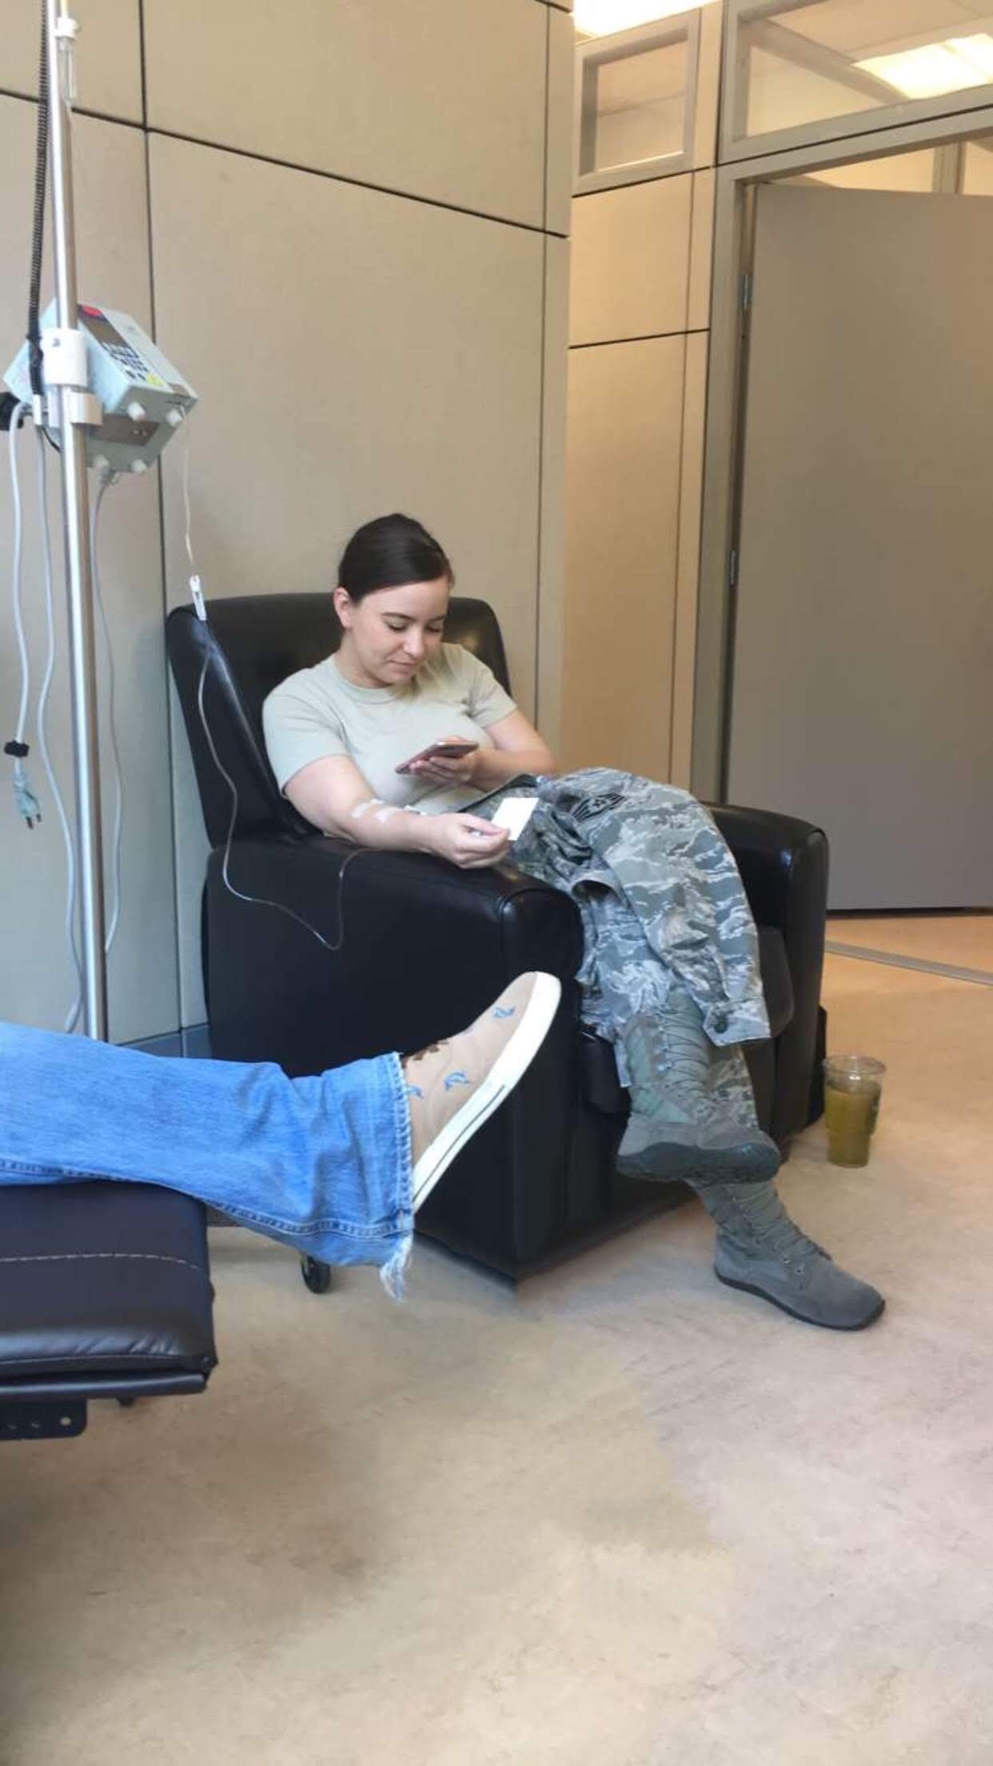
Use the Things You are going Through for a Purpose

Slide 18
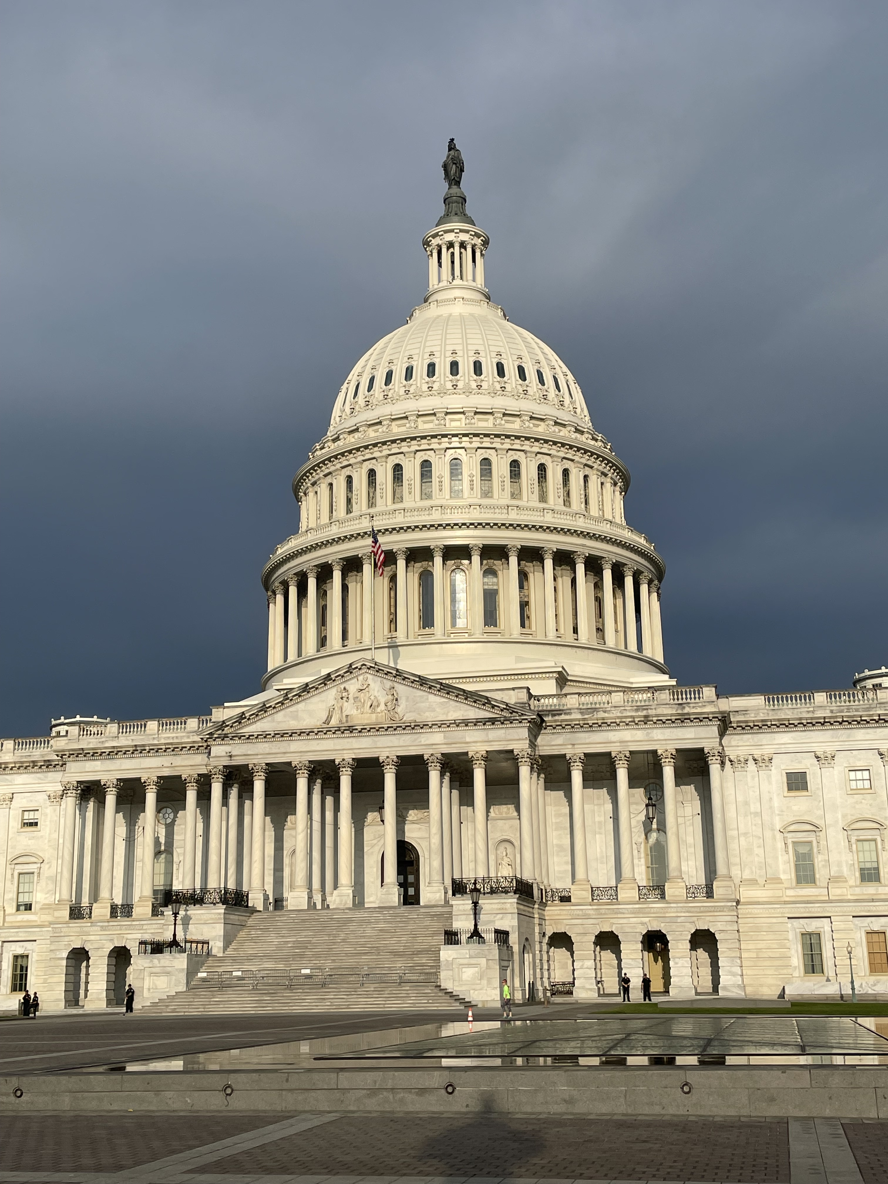
Research Drives Legislation
Data and Research are critical for pushing change to and introducing new legislation

Slide 19
Use Your Story to Help Others
You are the only person to live your life
Your experiences make you a subject matter expert
Researchers and Legislators both value your stories
How you navigate life is critical for understanding what needs to be changed

Slide 20
In Closing
You are an essential part of advocacy
How you advocate can look like a lot of different things
Do what makes you feel empowered and gives you purpose

Slide 21
Q&A
We are happy to answer any questions you may have.
This is just an overview of certain aspects of research advocacy.
Reach out to us any time at CherylV@PVA.org and LisaE@PVA.org.

