Slide 1
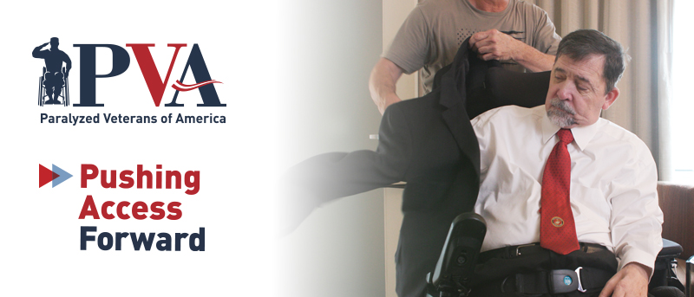
Preparing for Air Travel
Heather Ansley, Chief Policy Officer
Peter Axelson, Director of Research & Development, Beneficial Designs

Slide 2
Webinar Process
Today’s webinar will be recorded and available for viewing on PVA.org
Closed Captioning is available. Click the CC button in the meeting controls bar at the bottom of your screen to turn it on.
If you have a question, please type it in the Q&A box. Questions will be answered at the end of the program.

Slide 3
Agenda
Rights and Responsibilities
Empowerment Through Preparation
Questions

Slide 4
Rights and Responsibilities

Slide 5
Air Carrier Access Act (ACAA)
Signed into law in 1986.
Prohibits discrimination in air travel based on disability.
Applies to domestic airlines on all flights and foreign airlines on flights to or from the United States.

Slide 6
Americans with Disabilities Act & Air Travel
The Americans with Disabilities Act (ADA), which passed four years after the ACAA, explicitly does not apply to commercial air travel.
  The definition of public transportation [42 USC Section 12141(2)] excludes “transportation by aircraft.”
The ADA does apply to airports.

Slide 7
DOT Passenger Bill of Rights
Right to:
  Be treated with dignity and respect
  Receive information about services, in an accessible format
  Assistance in the airport and on the aircraft
  Travel with an assistive device and service animal
  Receive seating accommodations
  Accessible aircraft features (when required)
  Resolution of a disability-related issue
Notes:
Let the airline know ahead of time what accommodations you might need and what type of wheelchair or scooter you will be checking.

Slide 8
Assistance in the Airport
Passengers who self-identify as needing help must receive prompt and timely assistance from trained airline personnel or contractors.
Requirements to provide assistance begin at the curb. Help is is available for any connecting flights and upon arrival at your final destination.
If time allows, assistance can include stopping at a restroom.

Slide 9
Assistance on the Aircraft
Opportunity to preboard.
Receive assistance in boarding and deplaning from airline personnel or contractors.
  NEW training requirements are currently slated to go into effect next June!
Assistance using an on-board wheelchair to reach the lavatory.
Help in stowing and retrieving any assistive devices, including canes, crutches, or other items.

Slide 10
Traveling with a Wheelchair
Does NOT count against the number of items you can carry on the airplane.
Priority in-cabin stowage in either a closet or strapped to a seat.
  Manual wheelchair
  Can remove tires and other items to help chair fit in closet if no tools are needed to do so.
Power wheelchairs must be accepted as long as they will fit in the cargo compartment and meet other safety requirements.
  If you have a device with a lithium battery, contact your airline prior to day of travel if you have questions.
Notes:
Should an airline lose, damage, or destroy the wheelchair or other assistive device, the airline must provide compensation in an amount up to the original purchase price of the wheelchair or device.

Slide 11
Traveling with a Wheelchair
If you check a wheelchair or scooter, the airline must provide a written notice that you have the right to contact a complaint resolution officer (CRO), how to contact a CRO, and the right to file a claim if your device is mishandled.
  Mishandled: lost, delayed, damaged, stolen
You must be notified before the aircraft door closes whether your device has been loaded on the aircraft. If it hasn’t been loaded or won’t fit, you must be offered the opportunity to deplane and be rebooked on the next flight on either that airline or a partner airline.
You must be notified before you deplane as to whether your device was unloaded.

Slide 12
Mishandled Wheelchair
Your wheelchair must be returned to you in the same condition in which it was received by the airline.
When the airline or you notices that your device has been damaged, you must be immediately notified in writing of your right to file a claim with the airline, receive a loaner device, choose the repair vendor, and talk with a CRO.
If your device is delayed, it must be returned within 24 hours for domestic flights.
If your device is lost, damaged, or stolen, you must be given a reasonable time to inspect it and file a claim.
If repair or replacement is needed, the device must be promptly repaired or replaced with a device of equivalent or greater function and safety. If you choose your own vendor, the airline must also pay for transporting the device.
Notes:
Should an airline lose, damage, or destroy the wheelchair or other assistive device, the airline must provide compensation in an amount up to the original purchase price of the wheelchair or device—Not on international flights.

Slide 13
Traveling with a Service Animal
A service animal is a dog. No breed restrictions.
Airlines are not required to accommodate animals that are too large or heavy in the cabin.
Self-trained service animals are allowed.
Airlines may ask if the animal is required due to a disability and what work or task the animal has been trained to perform.
Airlines may require service animal users to provide DOT’s service animal forms up to 48 hours prior to travel.
Notes:
AFTER 2nd BULLET: Must fit on the passenger’s lap or in the passenger’s foot space. Not allowed in exit row.
AFTER LAST BULLET: The two DOT forms that may be required are: A form requiring the passenger to attest to the animal’s health, behavior, and training. AND A form attesting that the animal will not relieve itself or will do so in a sanitary manner—only for flights that are 8 hours or more.

Slide 14
Seating Accommodations
Airlines are required to provide you with seating accommodations needed due to a disability but only in your class of service.
Bulkhead seating is available for individuals with a service animal or a fused or immobilized leg.
An adjoining seat must be provided if you are traveling with a personal care attendant who will help you with a task not required to be completed by airline personnel, such as providing help with eating.
Notes:
AFTER 1st BULLET: So, they don’t have to accommodate you in first class if you bought a coach ticket. However, they shouldn’t charge you an extra fee to select a window seat.

Slide 15
Remedies Available Under the ACAA
Ask for a CRO.
Call DOT Disability Hotline at 1-800-778-4838 (8:30 a.m.-5:00 p.m. ET Monday-Friday).
File a complaint directly with the airline.
File a complaint with DOT.
  Online: https://secure.dot.gov/air-travel-complaint.
  May also be emailed or mailed.
No private right of action.

Slide 16
MSP Airport Disability Services
The Minneapolis St. Paul airport has service animal relief areas at both of its terminals.
Terminal 1 and Terminal 2 have relief areas pre and post security.
For more information on service animal relief areas and other services, visit: https://www.mspairport.com/airport/accessibility.
  MSP’s accessibility webpage includes information on accessible ground transportation, restrooms, and more.
Notes:
The MSP Airport maintains pet and service animal relief areas at both terminals.
Terminal 1 Locations:
Pre-Security Checkpoint:
North end of the Arrivals Level, outside of Door 1
South end of the Arrivals Level, outside of Door 4
Ground Level of the Rental Car Lobby in the Silver Ramp, outside of the doors on the east end of the building by the escalators
Post-Security Checkpoint:
Near entrance to Concourse E on the North end of the Mall
On Concourse F, near Gate F5
On Concourse C by Gate C13 on the mezzanine level north of the C/G Connector Skyway
Terminal 2 locations:
Pre-Security Checkpoint:
Use the grassy area just outside of Door 8, on Level 1, near baggage claim.
Post-Security Checkpoint:
On Concourse H by Gate H11.
Passengers traveling with a service animal can request an escort from their airline or Travelers Assistance to the pet relief area.

Slide 17

Airline Cancellation &
Delay Dashboard
View Dashboard Here:
https://www.transportation.gov/airconsumer/airline-cancellation-delay-dashboard
Notes:
Remember, flight delays and cancellations happen. Bad weather, mechanical issues, etc could interrupt your trip. Make sure you have anything you might need in your carryon baggage.
The U.S. Department of Transportation has created a dashboard to ensure the traveling public has easy access to information about services that U.S. airlines provide to mitigate passenger inconveniences when the cause of a cancellation or delay was due to circumstances within the airline’s control. A green check mark on the dashboard means an airline has committed to providing that service or amenity to its customers. A red “x” means the airline has not made that commitment. However, airlines with a red “x” may provide these services and amenities in some instances in their discretion.

