Slide 1
Storytelling for Advocacy
Presented by: Maureen Elias, Storytelling Instructor, Armed Services Arts Partnership

Slide 2


Slide 3

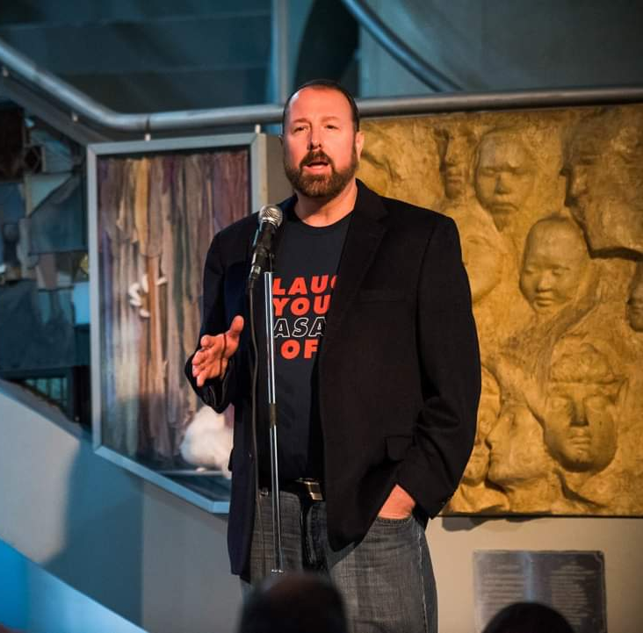

Slide 4
Agenda
Background
Why Stories
Finding Your Stories
Crafting Your Story
Ask Examples
Best Practices
After Advocacy

Slide 5
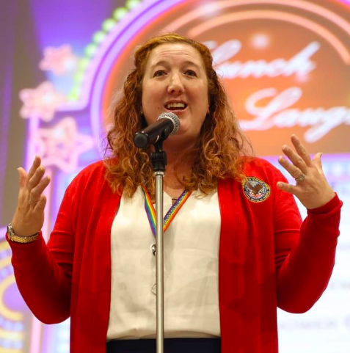
Background
Army Veteran and Military Retiree Spouse
Former PVA Employee
Hill Staffer
Senior VA Executive
Storytelling Instructor

Slide 6
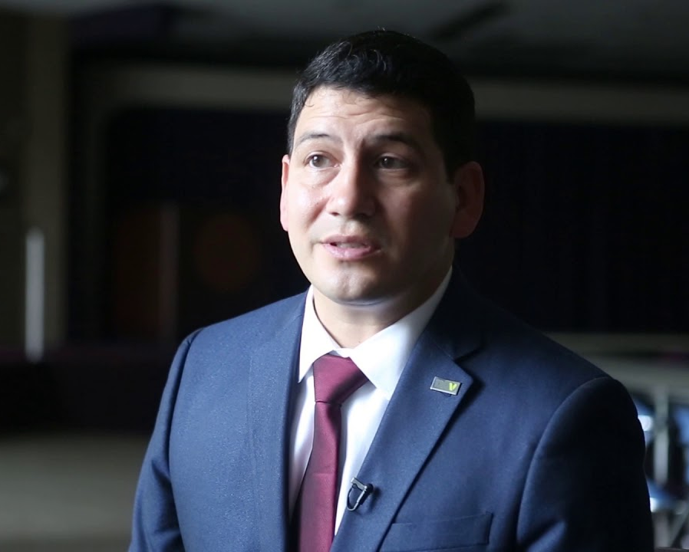
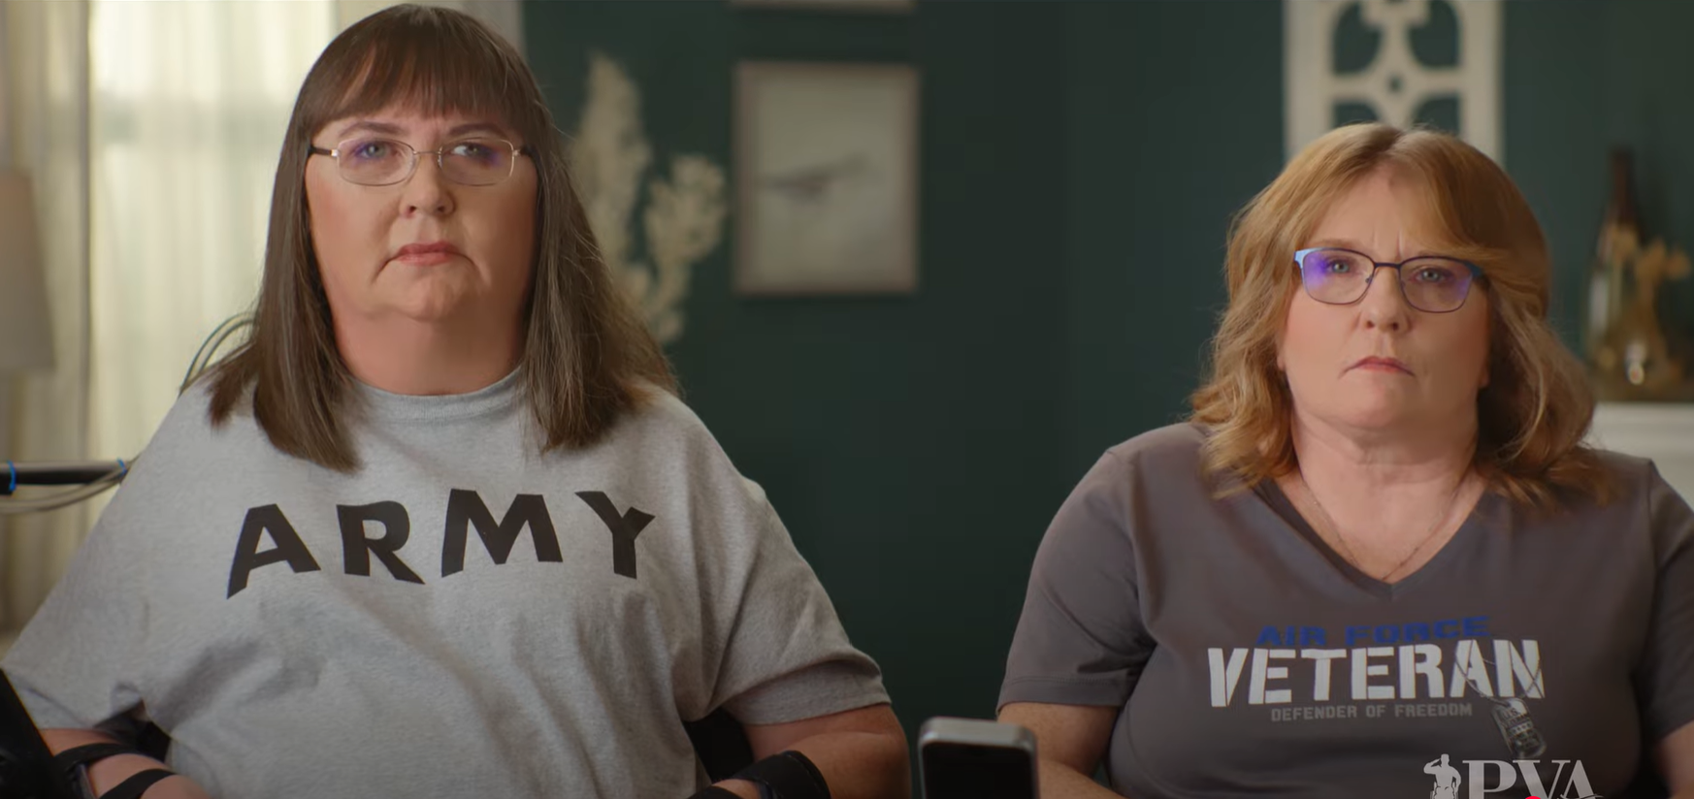
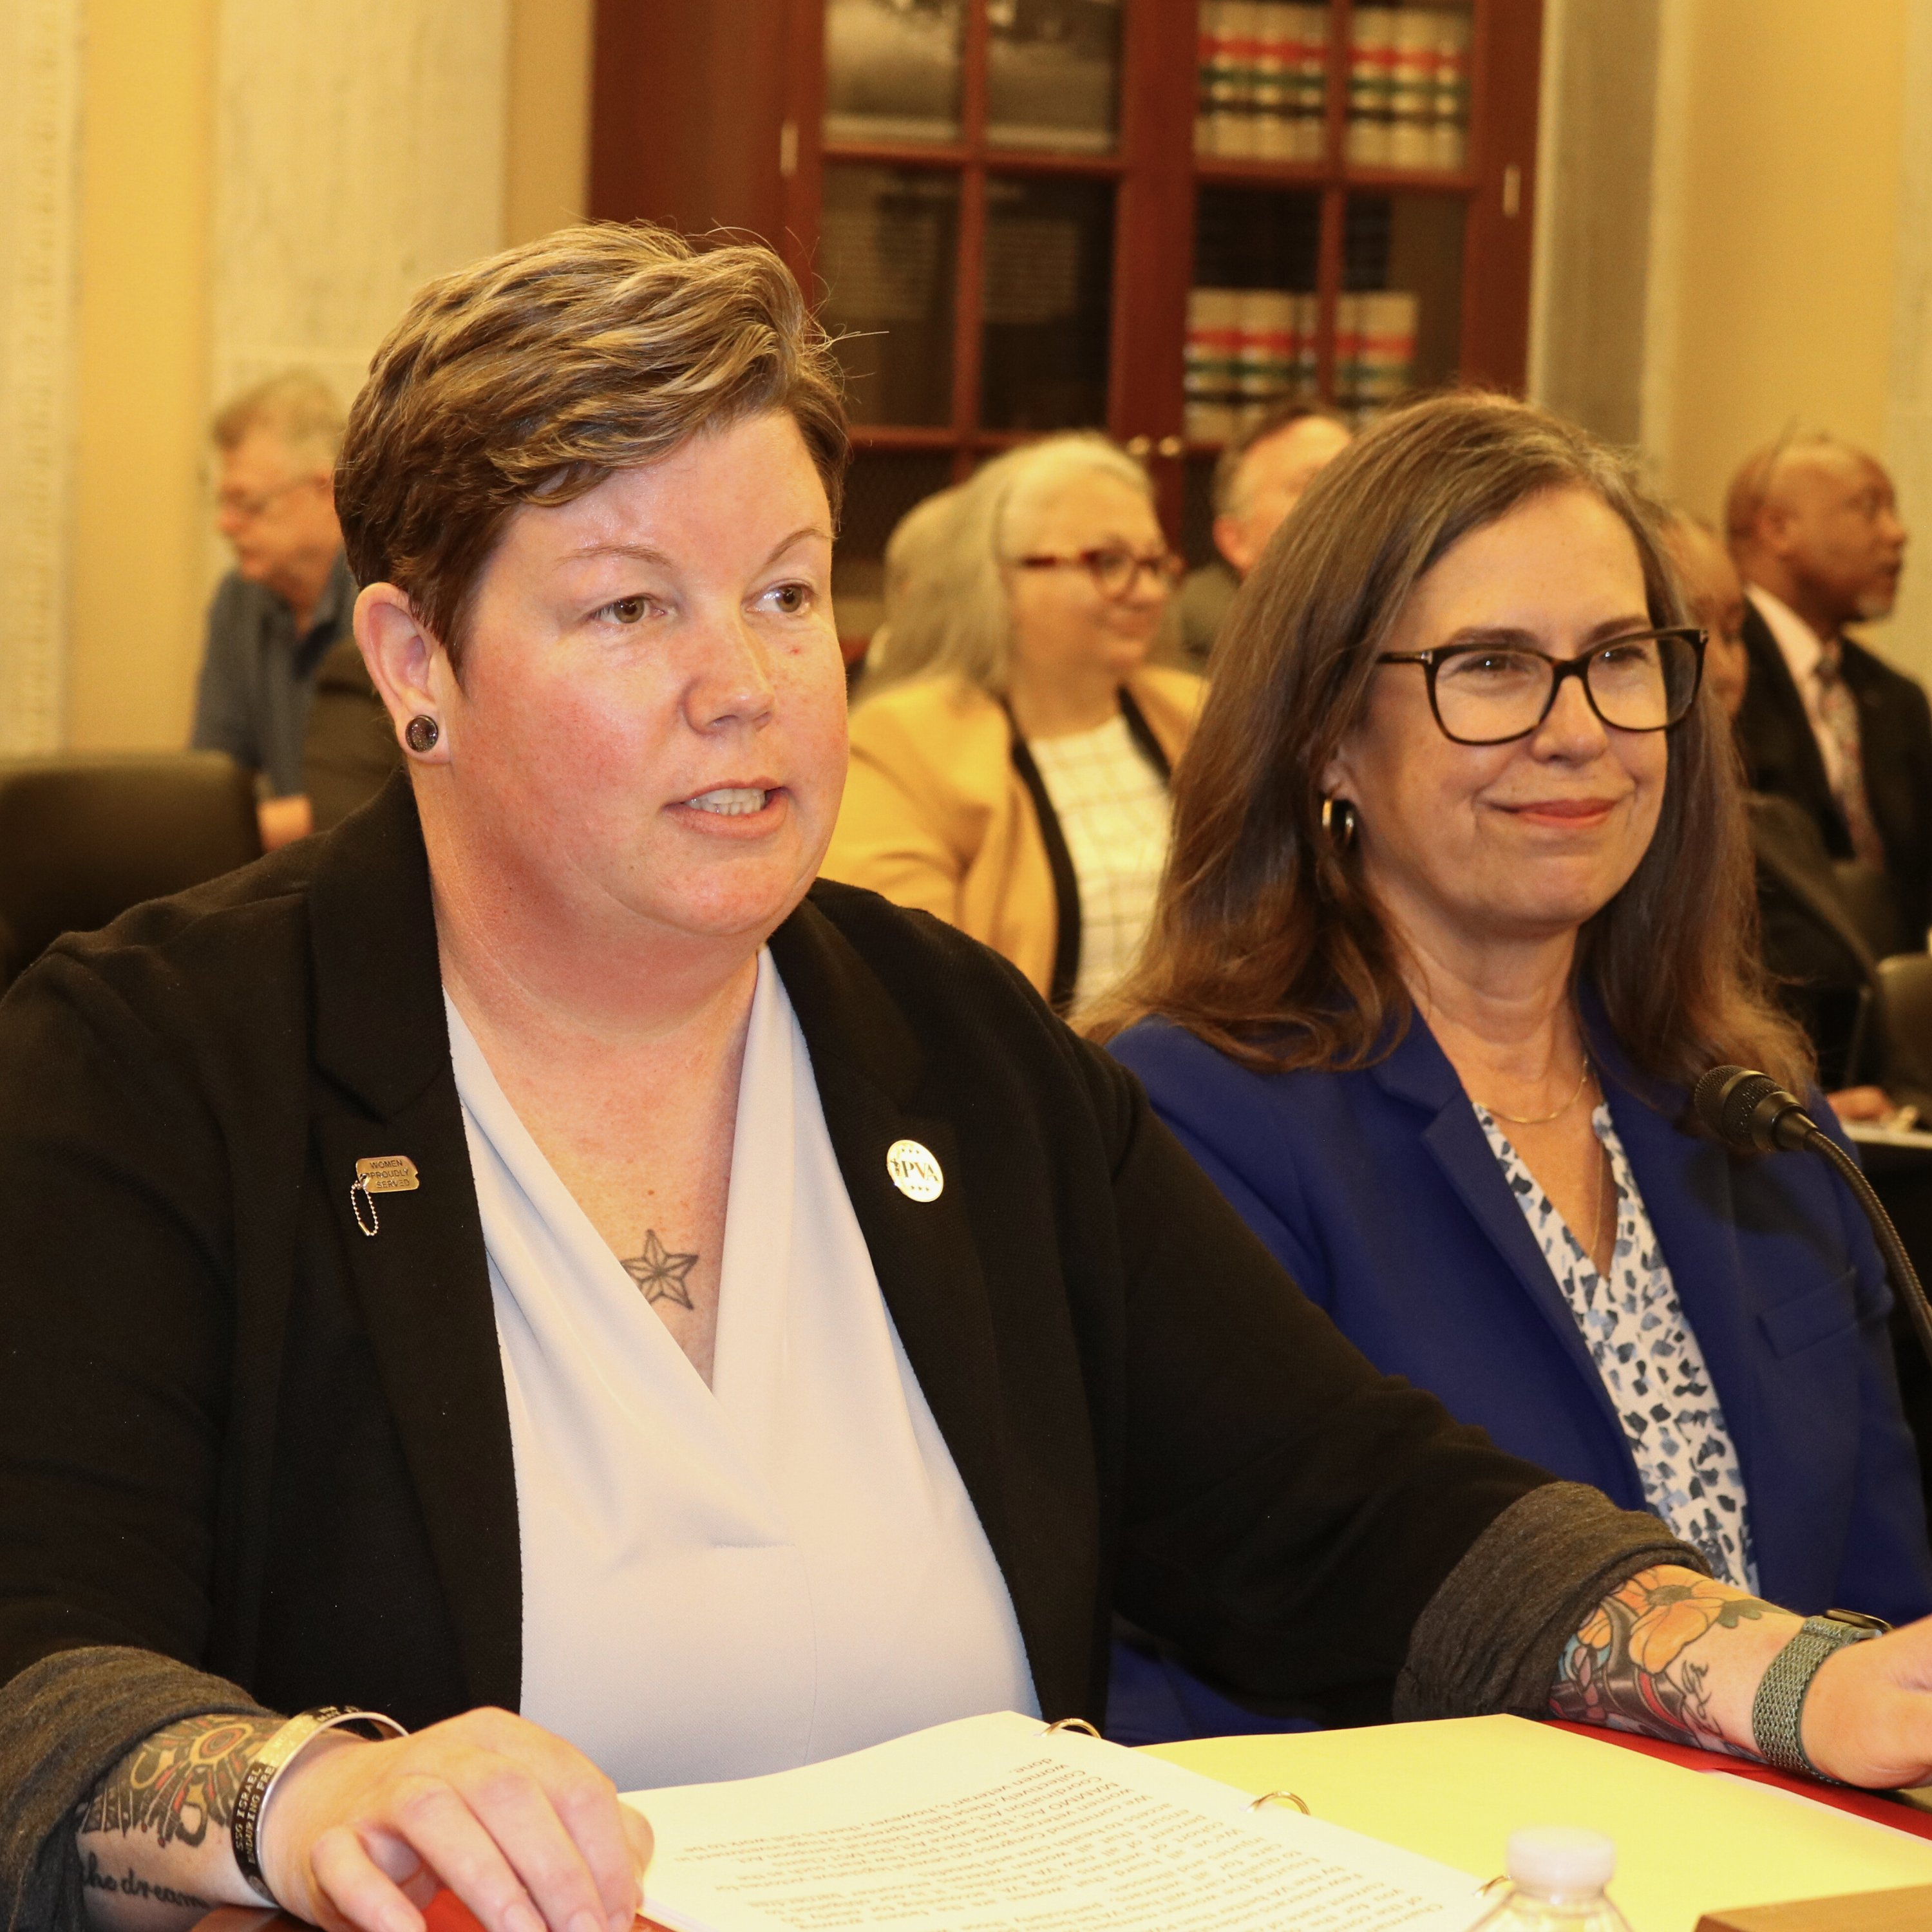
Why are Stories so Impactful in Advocacy?
Please type in the chat why you think stories are so impactful.

Slide 7
Why are Stories so Impactful in Advocacy?
Please type in the chat why you think stories are so impactful.
Build Emotional Connection
Create shared Understanding
Meaning Making
Inspire and Motivate
Influence and Persuade

Slide 8
Finding Stories to Harness
Triumphant
Heroic
Cowardly
Romantic
Lonely
Disgusted
Desperate
Delighted
Insecure
Amazed
Glamorous
Patriotic/Proud
Discombobulated
Rebellious
Seductive
Suspicious
Envious
Embarrassed
Wacky
Broken-hearted
Lucky
Remorseful
Saintly
Terrified
Silly/Giddy
Tricky/Sneaky
Happy
Vengeful
Frustrated
Lone Wolfish
Cursed
Inspired
Surprised
Amused
Grateful
Peaceful
Confused
Friendly
Nervous
Sentimental
Betrayed
Passionate
Diabolical
Humbled
Worried
Hateful
Empathetic
Homesick
Panicked
Excited
Powerful
Helpless
Spontaneous
Flummoxed
Uncompromising
Shy/Timid
Invincible
Foolish
Paranoid
Ruthless
Free-Spirited
Crazed
Motivated
Secretive
On the Verge
In Love
Playful
Amorous
Awed
Desirable
Empowered
Trapped
Grieving
Ashamed
Affectionate
Eager
Blissful
Satisfied
Restless
Tender
Hysterical
Devastated
Infatuated
Hurt
Alarmed
Defeated
Sexy
Relieved
Irritated
Adoring
Depressed
Nostalgic
Mad/Furious
Traumatized
Energized
Sad
Insulted
Rejected
Superior
Guilty
Innocent
Cheated
Stubborn
Joyful
Exasperated
Enthusiastic
Persecuted
Trusting

Slide 9
Finding Stories to Harness
  A lot of us think we only have one good story. Not true!
  Just about every good, bad, or interesting thing that has happened in your life can become a story.
  What is the difference between a story and an anecdote?
  Exercise Story seeds
    People
    Places
    Emotions

Slide 10
Crafting Your Story
Set-up: What is the norm at the time of the story? Who are the characters and what is
the setting?
Desire: What do you (the protagonist) want? And what is at stake for you if you do not
achieve your desire?
Inciting Incident: What event, decision, or action throws the protagonist’s life out of
balance and sends you (the protagonist) on a new path?
Rising Action: What problems or obstacles stand in the way of the protagonist’s desire?
What gets in your way, creating the rising tension of the story?
Climax: When does the central Q of the story get answered? What choice do you make
or action do you take to bring about the climax?
Resolution: What questions are answered? What has changed in you? What's your new
norm?
Notes:
Pro-tip: Keep your set-up short, to get to the story narrative quickly.
Note: Your desire drives the story and gives your audience
something to root for. Expressing your desire clearly helps your audience relate to you.
Note: The inciting incident is
the start of the narrative action. It’s the “and then one day, _____ happened” moment.
Note: The bulk of your
story falls under rising action. You want your biggest obstacles last, to build tension.
Note: This is not necessarily the most
exciting part of your story, though it can be.
Note: Your resolution may not wrap everything, but it shouldn’t leave any of the
main stuff hanging. Pro-tip: Having your last line call back to your opening is satisfying.

Slide 11
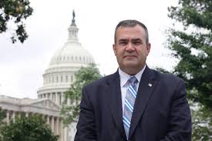
Story Crafting Tips
Open strong.
Make sure there’s enough YOU in your story.
Speak in the present tense.
Minimize context.
Use dialogue & act-outs.
Paint the picture (sensory).
Find your story’s frame or focus.
Build and develop your scenes.
Use the rule of threes.
Be flexible.
Notes:
Top 10 Story Crafting Tips
1. Open strong. Grab your audience’s attention immediately and hold it.
Best to start in something about you (an attitude, desire, feeling, or
confession,) or consider opening right in the narrative action.
2. Make sure there’s enough YOU in your story. Be vulnerable when you can.
3. Speak in the present tense to create immediacy & help build tension.
4. Minimize context, providing just enough to understand your story.
5. Use dialogue & act-outs wherever possible to bring characters to life.
6. Paint the picture: Include specifics & sensory details, but don’t overload.
7. Find your story’s frame or focus; check for opening & closing cohesion.
8. Build and develop your scenes; let them unfold in real time.
9. Use the rule of threes. The rhythm & magic of threes is your friend.
10 Be flexible; understand the difference between literal & emotional truth.

Slide 12
Crafting Your Story – In Practice
Using Air Travel as an example
Our daughter was expecting her first child. We live in Texas and she lived in Oregon. My wife and I wanted to fly out to be with her for the delivery. We got the call, “ Mom, Dad, I’m going to be induced tomorrow. I know it’s a couple weeks early but the doctor thinks this is best for me and the baby. I hope you can make it”. So, we bought our tickets and barely slept, we were so excited. I have a routine I follow before I fly where I reduce the food I eat and how much I drink because most airlines do not have disabled access on their airplanes. The flight to Portland is about four hours. Because I was not able to follow my normal routine, right as the plane took off, I started to feel the urge. I had drunken a lot of water that day because, as you know, San Antonio can get pretty hot and we thought we had more time before the baby was going to come. That is a long time to not be able to use the bathroom when you need to go. The urge grew and grew. I tried distracting myself by watching a new movie. I tried sleeping. But I was so uncomfortable. By the end of the flight, I was almost in tears, I needed to go so bad. Thankfully, we made it off the plane before anything embarrassing happened and we were able to join our daughter for the birth of her son.

Slide 13
Using Stories as an Advocacy Tool
Stories in Advocacy are tailored a little different than stories for the sake of art.
Tie your story into the topic(s) you are advocating for.
The story helps them understand the impact of what needs to be changed or what they want to change.
Helps build relationships.
Humanizes the policy issue.
Notes:
The ultimate goal of these efforts is not just a policy change but to develop a relationship.

Slide 14


Best Practices
Be Brief
Be authentic
Be a good listener
Be honest
Be prepared
Be engaging
AVOID
Avoid getting overly emotional
Avoid disregarding the clock
Using Jargon
Being disappointed if you don’t get in to see your Congressperson
Notes:
Their time is limited. You want to leave room for a conversation. Keep your story brief.
Ask yourself, does my story need this information to make sense? If not, cut it.
They can smell BS a mile away. They get pitched all day by professionals who are paid to do this work. Your authenticity will make you stand out.
If they are talking and asking questions, be fully present. They will often throw curve ball questions and if youre worried about what you want to say next you may miss it.
If you don’t know something, don’t make it up. Its ok to say I don’t know, but promise to follow up with the answer.
Practice the pitch. This will help you sound confident and well versed.
Talk with passion, energy, enthusiasm, and determination in your voice.

Slide 15
The Ask - Examples
This is why I am asking you to support H.R. XXXX.
I wanted to thank you for sponsoring S. XXXX, and I ask for your continued support as the bill reaches the floor.
Thank you for supporting S. XXXX and pushing it past the finish line into law.
That is why it is so important for you to support S. XXXX.
Will you be able to support H.R. XXXX to help veterans like me?
Thank you for your continued support of the disabled veteran community.

Slide 16
PVA Policy Priorities
Protect VA’s Specialized Health Care Services
Increase Access to Long Term Services and Supports for Veterans with SCI/D
Improve Veterans’ Financial Security
Enhance Access to Health Care Services for Veterans with SCI/D
Defend the Freedoms of Veterans with Disabilities

Slide 17

After Advocacy
Follow up! Keep building on the relationships you make.
Continue to be an advocate.
Continue to share your story.
Armed Services Arts Partnership (ASAP) provides free storytelling, comedy, improv and art classes to veterans, service members, military spouses, family members, and caregivers. www.asapasap.org

Slide 18
Questions and Elevator Pitch Examples

