Slide 1


Slide 2

Preparing to Advocate During PVA’s Annual Testimony

Slide 3
Webinar Process
Today’s webinar will be recorded and available for viewing on PVA.org
Closed Captioning is available. Click the CC button in the meeting controls bar at the bottom of your screen to turn it on.
If you have a question, please type it in the Q&A box. Questions will be answered at the end of the program.

Slide 4
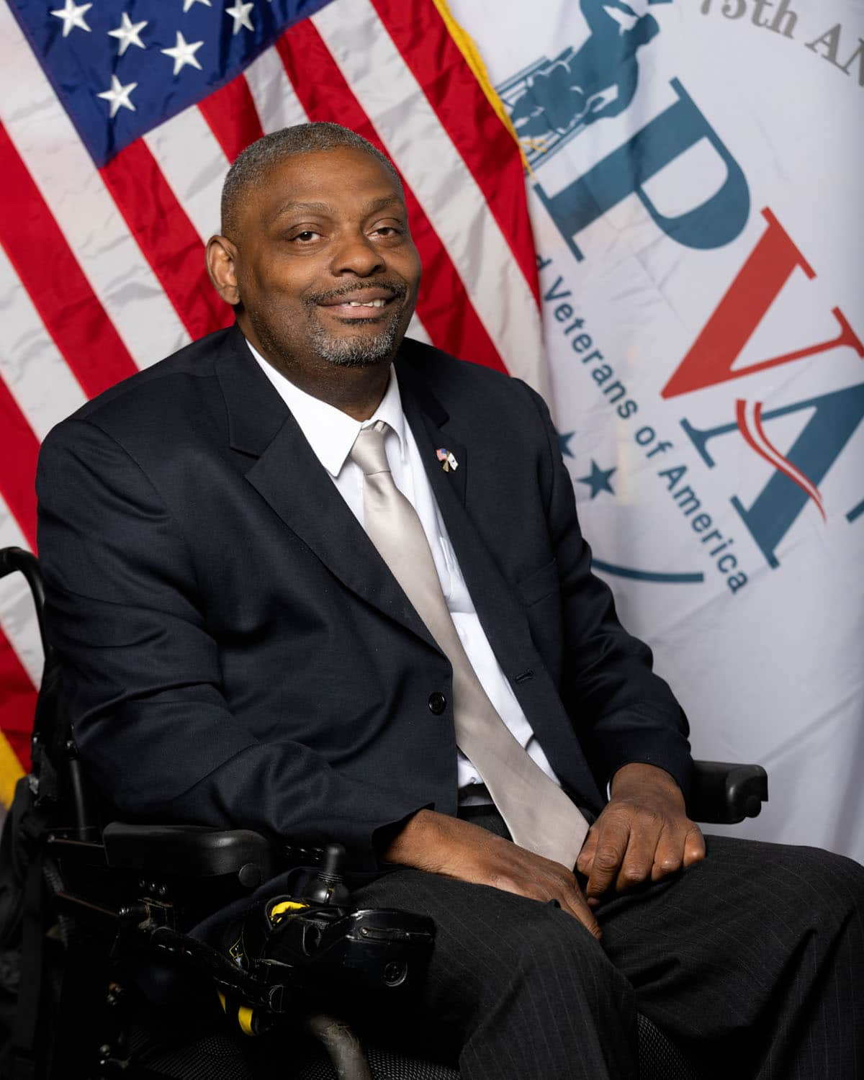
Special Welcome
PVA National President & Chairman of the Board Robert Thomas

Slide 5
Meeting Overview
Priorities Update
Testimony Overview
Walkthrough of VoterVoice and Petition

Slide 6
Q&A
We are happy to answer any questions you may have.

Slide 7
Resources
Heather Ansley – HeatherA@pva.org
Morgan Brown – MorganB@pva.org
Lisa Elijah – LisaE@pva.org

