Slide 1


Slide 2
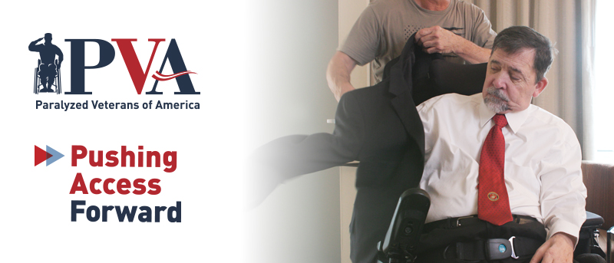
Facets of Advocacy:
Protecting Disability Rights Through Regulations
Anthonya James, Esq., Advocacy Attorney
Danica Gonzalves, Esq., Senior Advocacy Attorney

Slide 3
Welcome & Process
Today’s meeting will be recorded and shared with registrants.
Closed Captioning is available. Click the CC button in the meeting controls bar at the bottom of your screen to turn it on.
If you have a question, please hold it until our Q&A or post it in Q&A box.

Slide 4
Disability Advocacy at a Glance
July is Disability Pride Month
July 26 – Anniversary of the Americans with Disabilities Act
September 26 – Anniversary of the Rehabilitation Act
Disability civil rights laws ensure equal opportunity for people with disabilities
Understanding and participating in the regulatory process is crucial

Slide 5
Agenda
Regulations
Advocacy During the Regulatory Process
Tips for Effective Public Comments
Successful Regulatory Advocacy
Pending Regulations
Q&A

Slide 6
What's the Difference Between Laws and Regulations?
Laws
System of rules or statutes
Passed by both houses of Congress
Regulations
Standards and rules created by federal agencies
Govern how laws will be implemented

Slide 7


Regulations Road Map
Agency decides to begin rulemaking
Advanced Notice of Proposed Rulemaking (ANPRM)
Public Comment Period
Notice of Proposed Rulemaking (NPRM)
Public Comment Period
Agency reviews comments
Agency publishes Final Rule (FR)

Slide 8
Advocacy During the Regulatory Process
Public comments
  Provide input on rulemaking
  Normally ranging from 30 to 60 days
Resource: Regulations.gov FAQ

Slide 9
Advocacy During the Regulatory Process
Public meetings/hearings
  Agencies can:
    Collect information
    Provide information
  Members of the public can:
    Make statements
    Ask questions

Slide 10
How to Read a Proposed Rule
Preamble – summary and reason for rulemaking
Supplementary information – reasons for proposals
Proposed regulations – issues and proposals
Questions – seeks specific answers from public
Regulatory text – actual text for proposed regulation

Slide 11
Tips for Writing Effective Public Comments
Read the proposal
Explain who you are/why you are submitting a comment
Answer the questions posed
  Directly state if you oppose/support proposal and provide rationale
  Can offer alternatives
Resource: Tips for Submitting Effective Comments

Slide 12
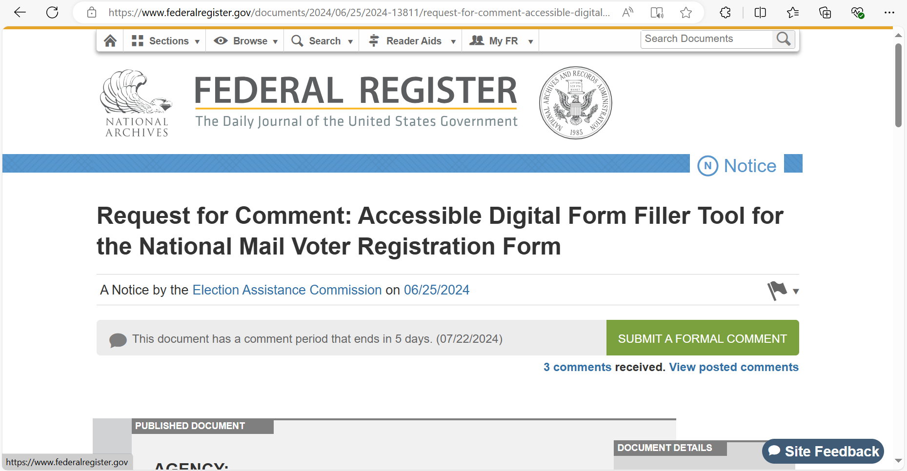
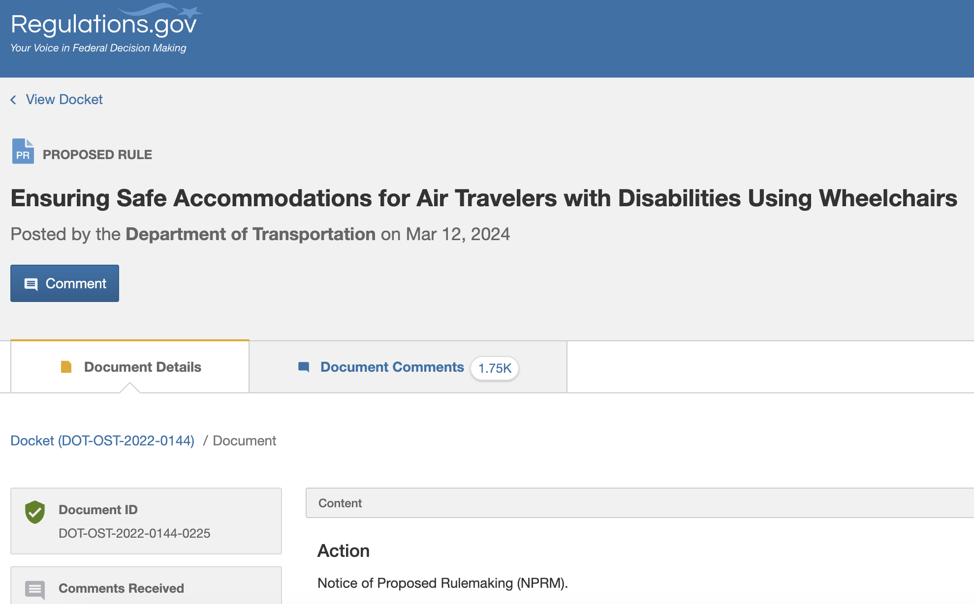
Submitting Public Comments
Federalregister.gov
Regulations.gov

Slide 13
Successful Regulatory Advocacy
ADA Title II – Website & Mobile App Accessibility
  Applies to state and local governments
  Requires specific technical accessibility requirements
Air Travel Ticket Refund Requirements
  Requires airlines to offer refunds if there is a "significant change" to the itinerary
  Additional requirements for passengers with disabilities
    No longer providing needed accessibility features
    Applies to other passengers on the same reservation

Slide 14
Successful Regulatory Advocacy
Department of Health & Human Services (HHS) Section 504 final rule
  Strengthens Section 504 of the Rehabilitation Act - prohibits discrimination in programs and services that receive federal funds
    Outlines discriminatory actions
    Expands definition of a wheelchair
    Gives requirements for accessible medical diagnostic equipment (e.g., exam tables and chairs, scales, and mammography & imaging equipment)

Slide 15
Pending Regulations
Dep't of Transportation – Ensuring Safe Accommodations for Air Travelers With Disabilities Using Wheelchairs
  Safe, dignified, and prompt assistance
  Mishandled devices, repairs, and loaner wheelchairs
  Training requirements of airline personnel
Access Board – Low Transfer Height of Medical Diagnostic Equipment
Dep't of Justice – ADA Title II Accessible Medical Diagnostic Equipment
  Matching requirements under HHS Section 504 final rule

Slide 16
  Questions?

Slide 17
Anthonya James
Advocacy Attorney
AnthonyaJ@PVA.org
(202) 416-7791
Danica Gonzalves
Senior Advocacy Attorney
DanicaG@PVA.org
(202) 416-7790

