Slide 1
Preparing to Advocate During PVA’s Annual Testimony
February 27, 2024
Notes:
Good afternoon everyone! Thank you for joining us for todays webinar on preparing to advocate during PVA’s Annual Testimony. Let’s dive right in!

Slide 2
Webinar Process
Today’s webinar will be recorded and available for viewing on PVA.org​
Closed Captioning is available. Click the CC button in the meeting controls bar at the bottom of your screen to turn it on.​
If you have a question, please type it in the Q&A box. Questions will be answered at the end of the program.
Notes:
A few Short notes about todays webinar. The webinar will be recorded and available for viewing on PVA.org. Closed Captioning is available. Please click the CC button in the meeting controls bar at the bottom of your screen to turn it on. If you have a question, please type it into the Q&A box. Questions will be answered at the end of the program.

Slide 3
Special Welcome
PVA National President & Chairman of the Board Robert Thomas
Notes:
I wanted to extend a VERY special welcome to our PVA National President and Chairman of the Board – Robert Thomas. Robert, thank you so much for joining us. Please join us and share a few word with everyone.
Thank you so much Robert.

Slide 4
Webinar Overview
Priorities Update
Heather Ansley, PVA’s Chief Policy Officer
Testimony Overview
Morgan Brown, PVA’s National Legislative Director
Lisa Elijah, PVA’s Grassroots Advocacy Manager
Overview of PVAction Force and Testimony Toolkit
Lisa Elijah
Jennifer Hill, PVA’s Digital Content Specialist
Notes:
A quick overview of todays webinar. We will have an update on our priorities from Heather Ansley, PVA’s Chief Policy Officer, then I will be joined on screen with Morgan Brown, PVA’s National Legislative Director. For those I haven’t had the pleasure of meeting yet, I am Lisa Elijah, PVA’s Grassroots Advocacy Manager. Finally, we will finish off with an overview of PVAction Force from myself, before I hand it over to Jennifer Hill, PVA’s Digital Content Specialist. Now I am going to hand it over to Heather to speak on our 2024 priorities.

Slide 5
PVA’s 2024 Priorities
Protect Access to VA's Specialized Health Care Services
Expand Access to VA Long-Term Services and Supports
Improve VA Benefits and Health Care Services for Paralyzed Veterans and their Survivors
Protect the Civil Rights of People with Disabilities
Improve Access to Social Security Benefits
Increase Employment Prospects for Veterans with Disabilities

Slide 6
PVA’s 2024 Priorities—Resources
PVA’s policy priorities webpage: https://pva.org/research-resources/policy-priorities/.
Includes links to:
PVA’s 2024 Priorities Overview
PVA’s 2023-2024 Veterans Journey Legislative Map
PVA’s 2024 policy papers:
Protect Access to VA's Specialized Health Care Services
Expand Access to VA Long-Term Services and Supports
Improve VA Benefits and Health Care Services for Paralyzed Veterans and their Survivors
Protect the Civil Rights of People with Disabilities
Improve Access to Social Security Benefits
Increase Employment Prospects for Veterans with Disabilities
Notes:
Member toolkit slide is next

Slide 7
Testimony Social Media
Using Your Voice For #PushingAccessForward
Presented by: Jennifer Hill
ParalyzedVeterans

Slide 8
Goals of Testimony Social Media
Leverage the power of social media to promote testimony
Encourage family and friends to send PVAction Force letters
ParalyzedVeterans

Slide 9
2024 PVA Testimony Member Toolkit
The toolkit provides essential materials to achieve these goals
ParalyzedVeterans

Slide 10
Tips for Promotion: Behind-the-Scenes
Take behind-the-scenes photos and videos of you or your Chapter watching the testimony
Record short videos expressing excitement about this year’s PVA testimony and/or thoughts on PVA’s new priorities
Share your posts and content with Comms Digital Content Specialist Jennifer Hill at JenniferH@pva.org
ParalyzedVeterans

Slide 11
Tips for Promotion: Use Support System
Direct your family, friends, and colleagues to the PVAction Force website
Remind them it only takes a minute to sign on and it makes a huge difference for the entire disability community
ParalyzedVeterans

Slide 12
Tips for Promotion: Use Toolkit Content
Leverage our pre-written social media copy and crafted images to easily share on your channels
Once a follower or friend has posted, retweeted, or shared your social media content about PVA’s priorities, thank them by liking their post and/or sharing their posts on your page
ParalyzedVeterans

Slide 13
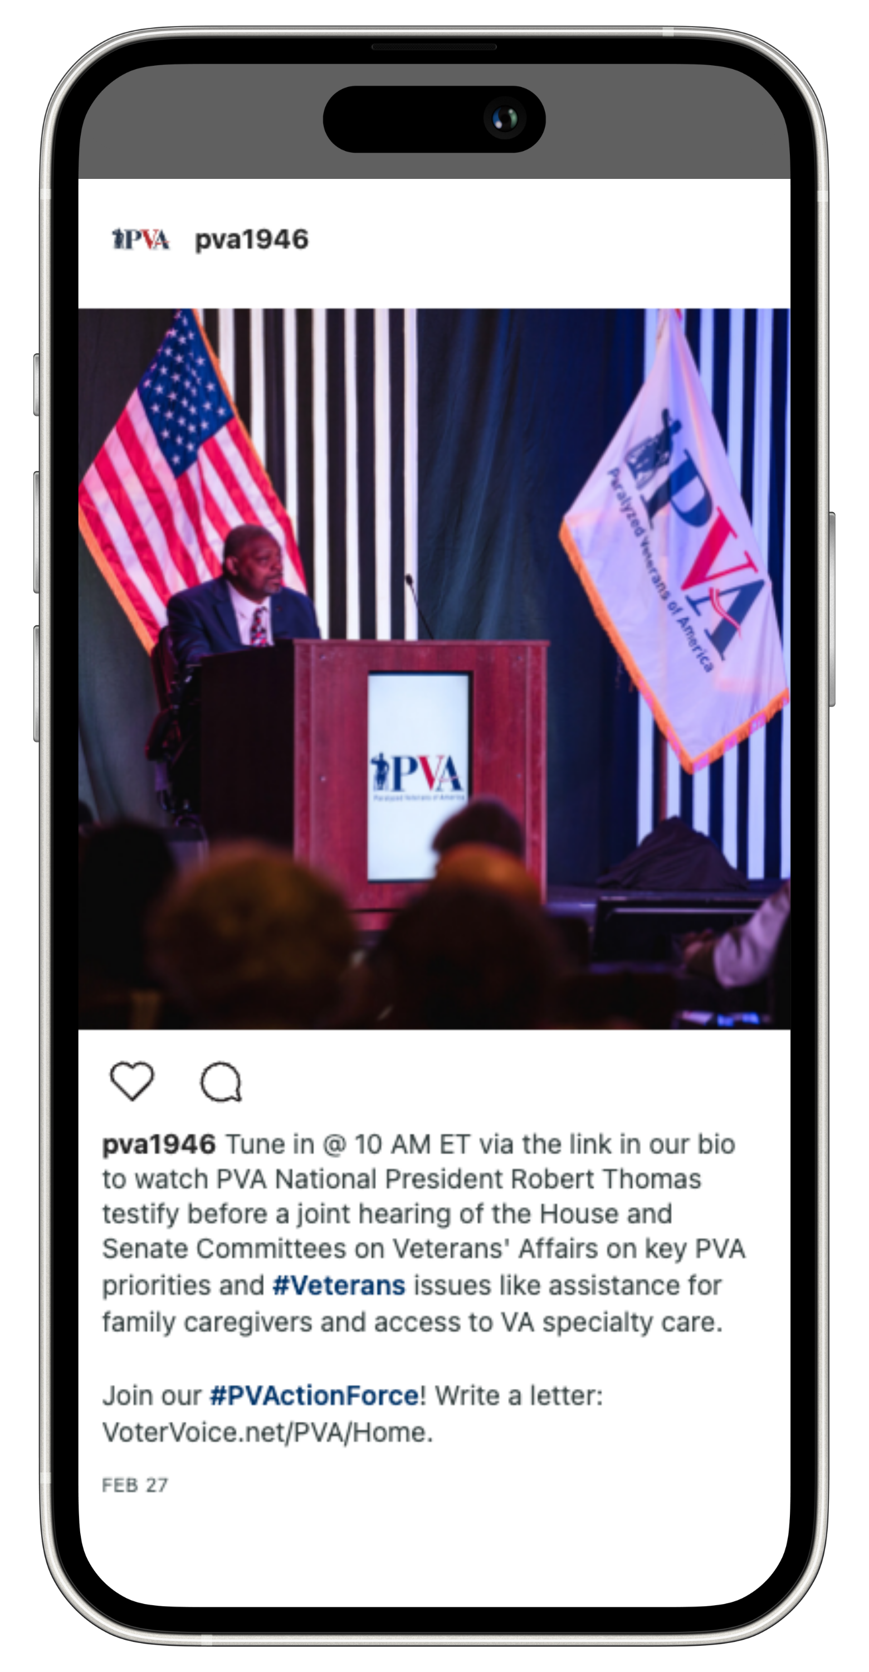
Sample Social Media Posts + Images
ParalyzedVeterans

Slide 14
PVA Social Media Handles and Hashtags
Accounts
Facebook: @ParalyzedVeterans
Instagram: @pva1946
LinkedIn: @Paralyzed Veterans of America
Twitter: @PVA1946
Hashtags
#PushingAccessForward
#PVActionForce
ParalyzedVeterans

Slide 15
How To Find/Tag Congressional Reps
Live Demo
8232 Gunston Corner Ln, Lorton, VA 22079
ParalyzedVeterans

Slide 16
Conclusion
Your involvement on social media can make a tremendous impact
Let's work together to spread the word about PVA’s priorities and the upcoming testimony!
If you have any questions, email me at JenniferH@PVA.org
ParalyzedVeterans

Slide 17
What are your questions or concerns?
ParalyzedVeterans

