Slide 1
PVA Postal Matches
Presented by: John Arbino

Slide 2
Air Guns – Postal Match
AGENDA
Postal Matches
Classification
Spring Stands
Home Range
Scoring Targets
Match Program
Resources

Slide 3
Postal Matches
Postal Matches are currently held at the National level using the Orion Scoring System.
Allow competitors to shoot at their home range and compete against others across the country.

Slide 4
Classification
SH-1
This classification applies to athletes who have the strength and ability to safely hold, load and fire an gun
SH-2
This classification applies to athletes who have limited use of one limb/hand.
These athletes are permitted use of:
Loading assistant
Trigger adaptation, such as sip/puff trigger.
Spring stand
SH-3/VI
This classification applies to athletes who are vision-impaired.
These athletes are permitted to use the ECOAIMS system, which uses sound to find the target center.

Slide 5
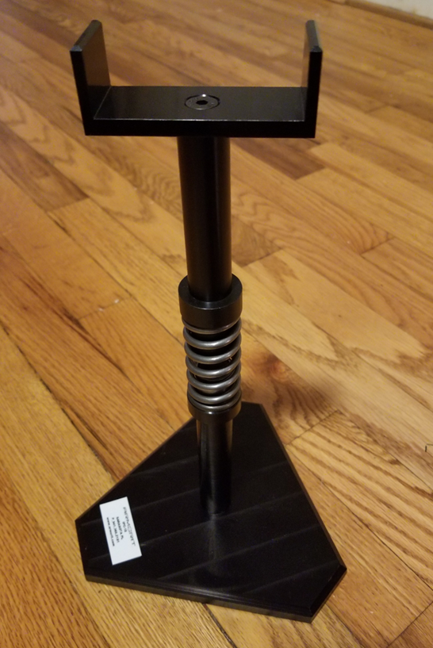
Spring Stand
All SH2 athletes will use an approved support stand to support the weight of the rifle.
The Classifier will assess muscle power in the shooting arm for the purpose of identifying if the athlete may use a weak, or strong spring on the rifle
Athlete’s will be allocated a subclass – ‘a’ or ‘b’
SH-2a or SH-2b
a - Weak Spring (white insert) min flexibility 35mm
b - Strong Spring (black insert) min flexibility 25mm

Slide 6
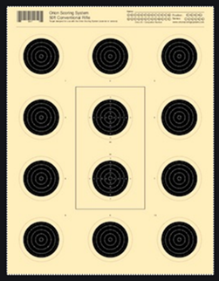
Building a Home Range (1 of 3)
10 meters (32.8 feet)
There can be no physical contact with the ground beyond the 10 meter firing line:
- If shooting from a wheelchair, then the front caster can not pass the 10 meter firing line.
If shooting from a table, then the table leg cannot pass the10 meter firing line.
Shooter can have feet on floor, or wheelchair footplate.
Firing Line

Slide 7
Building a Home Range (2 of 3)
1.4 meters (4.6 feet)
from the ground
Target Height

Slide 8
Ensure a pellet will penetrate the front of the box where the target attaches. If not, then the pellets with ricochet off the box. Something like cardboard or foam board works well.
Building a Home Range (3 of 3)
Air Venturi Pellet Box
*details on resource slide

Slide 9
Postal Match Program (1 of 2)
Targets
- The PVA will provide paper targets to all participating Chapters.
- Each target should include the veteran’s first/last name, Classification (SH1, SH2 or SH-3/VI) and the date.
- A clear photograph, or scanned copy of the target will then be emailed to johnar@pva.org for scoring.
- Those with electric targets may submit a photograph of a print out of their score. They may also submit a picture of their final shot, which should show their final score.

Slide 10
Postal Match Program (2 of 2)
Match Timing
Match begins with a 15-minute sighter/preparation time
Paper targets: SH1 & SH2 - 75-minutes for 60 shots
SH-3/VI - 75 Mins for 40 shots
Electronic targets: SH1 – 50-minutes for 60 shots
SH2 – 60-minutes for 60 shots
SH-3/VI – 75 Mins for 40 shots

Slide 11
Postal Match Schedule
The PVA Postal Match will run from Nov 22 to Mar 23, with targets due by the last day of each month.
Provides Chapters hosting matches, or members shooting at home, the flexibility of participating around their schedule.
The first set of targets will be due by 30 Nov 22. Targets can be submitted for as many, or few, months as members are able to shoot.
Awards will be given to the participant with the highest average of their best three months for each Classification.

Slide 12
LEAD PELLETS
Reminder that these are lead pellets
Anyone handling the pellets should avoid placing their hands near their eyes, or mouth.
Wash hands with cool water

Slide 13
GUN SAFETY CONSIDERATIONS
for every range
ALWAYS Keep the gun pointed in a safe direction
ALWAYS Keep your finger off the trigger until ready to shoot
ALWAYS Keep the gun unloaded until ready to use.

Slide 14
Resources (1 of 2)
These are recommended for those new to shooting, and are not ready to invest in a higher end precision rifle.
*These are also provided as loaners for the NVWGs
Crosman Challenger – Air rifle
https://www.crosman.com/product/challenger
Crosman 2300s – Air pistol
https://www.crosman.com/product/crosman-2300s-silhouette-competition-co2-air-pistol-177-caliber
Champions Choice - Air guns/supplies
http://www.champchoice.com/store/main.aspx
Oberle Enterprises – Shooting supplies
https://oberleenterprises.com/
Pyramyd Air - Air guns/supplies
https://www.pyramydair.com/air-guns
Spring Stands – Armorit (Required for SH2 only)
Tommie Cassaday, tlcassaday@armorit.com, 941 360 2101
These are a few suppliers of competition air guns and equipment.
You must contact Ms. Cassaday directly to purchase a Spring Stand as they are built per order. The prices were $85 (non-adjustable) and $115 (adjustable), plus shipping.

Slide 15
Resources (2 of 2)
Target Box – Air Venturi Pellet Trap - https://www.pyramydair.com/product/air-venturi-quiet-pellet-trap-incl-ballistic-putty-steel-backstop?a=5382
BEADAPTIVE – https://beadaptive.com/product-category/hunting-shooting/
(Adaptive trigger mechanisms)
NRA Disabled Shooting Sports – https://adaptiveshooting.nra.org/
Paralympic Shooting Rules
(For those competing at the NVWGs; we follow these rules as closely as possible.)
https://www.paralympic.org/shooting/rules
Paralympic Shooting Sports Classification
https://www.paralympic.org/shooting/classification

