Slide 1
Adaptive Housing
Various Resources for an Adaptive Home & an Independent Life
Presented by:
PVA, Habitat for Humanity, &
The Department of Veteran Affairs

Slide 2
Welcome & Webinar Process
Today’s webinar will be recorded and available for viewing on PVA.org
Closed Captioning is available. Click the CC button in the meeting controls bar at the bottom of your screen to turn it on.
If you have a question, please type it in the Q&A box. Questions will be answered at the end of the program.

Slide 3
Agenda
Introductions
Descriptions of each program and resources
Legislation to watch
Q&A

Slide 4
Introductions
Julie Howell, Associate Legislative Director, PVA
Wayne Broadfield, Associate Director of Architecture, PVA
Jason Latona; Chief, Specialty Adapted Housing, Dept. of VA
Michael DeLaRosa; 2nd Director of Veterans Build, Habitat for Humanity

Slide 5
Specially Adapted Housing Department of Veteran Affairs Flip to other presentation

Slide 6
Habitat For Humanity Veterans Builds

Slide 7
Build. Educate. Employ. Engage. Honor.
Michael A. DeLaRosa | US Marine
mdelarosa@habitat.org
Notes:
Good day, everyone. It's my pleasure to speak with you today about Habitat for Humanity’s work with Veterans and military-connected families. As a global non-profit organization, our mission is centered on making a tangible difference in people’s lives.

Slide 8
Habitat for Humanity International
Habitat for Humanity International (HFHI) aims to provide grant making, technical assistance, and support to our affiliate network of 1,000+ local sites across the US
Each Habitat site are their own 501(c)3 organization, with their own board of directors
Habitat programming varies by site, all sites create affordable homeownership opportunities for low-income families, some sites also do home preservation, other do a range of additional programs
Notes:
Since our inception in 1976, Habitat for Humanity has been instrumental in aiding over 29 million people across more than 70 countries, offering safe, decent, and affordable housing for families in need. Our unique approach involves partnering with families willing to invest their own labor into building their homes, alongside community volunteers and our dedicated staff. This fosters not only vibrant neighborhoods but instills a profound sense of pride and ownership in these families. Beyond construction, our efforts extend to addressing systemic barriers to affordable housing through advocacy and community engagement.

Slide 9
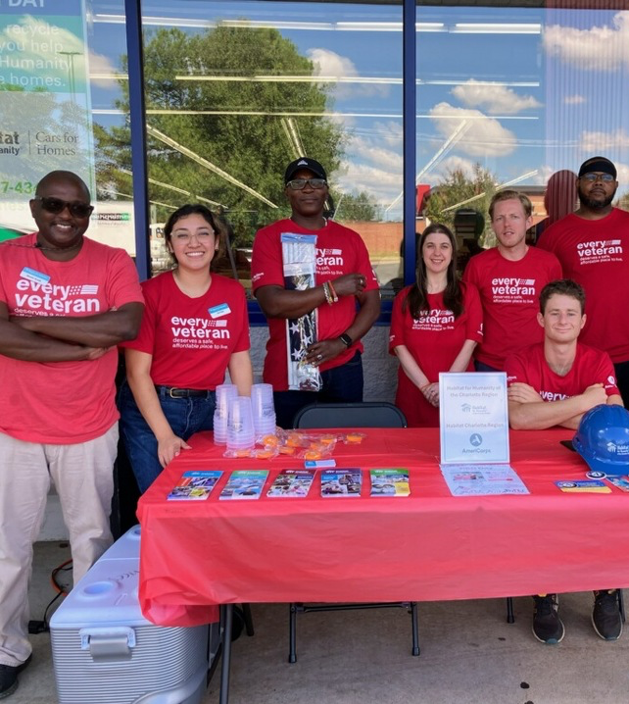
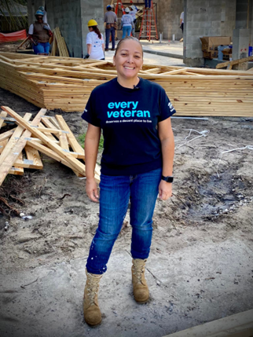
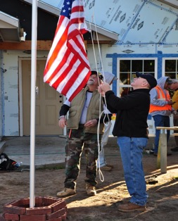
The Pillars
Veterans Build - The Pillars
BUILD
EDUCATE
EMPLOY
ENGAGE
HONOR
Programs to build, maintain and preserve homes and make them more accessible, energy-efficient and affordable.
We offer workshops on financial literacy, home maintenance, and more to empowering Veterans with knowledge.
We value skill sets gained from military service. We recruit Veterans to work at Habitat as employees, board members, extended volunteers, and AmeriCorps members.
We provide experiences help bridge the gap and ease the transition to civilian life and communities come together and foster connections.
Throughout the year, we host and participate special events that pay tribute to Veterans, raise awareness and mobilize volunteers.
Notes:
Today I’d like to provide an overview of the Habitat’s initiative to serve military and Veterans families, where our mission, in human-centered design goes beyond building homes. We're part of a larger movement to rectify historical injustices in housing, especially for our Veterans and military-connected families. By empowering Veterans and others facing systemic barriers, we're not only providing and preserving homes but restoring honor and dignity to those who've served our nation and our communities.
Through Veterans initiative, we provide a variety of services and programs that are tailored to the unique needs of the communities for Veterans and military-connected families. This includes home preservation, accessibility, modifications, and rehabilitation or repair programs, as well as new home construction projects.
We also work closely with other organizations, like the Department of Veterans Affairs, state-wide organizations and community partners to provide a range of support services, including financial counseling and job training programs. These collaborations are designed to help Veterans and their families build a solid foundation for their future and achieve lasting affordability and generational wealth.

Slide 10
Affordable Homeownership
100+ New Veteran Homeowners annually
5+ Veteran large-scale neighborhoods annually
2+ Formerly Homeless Veterans affordable homeownership converting their rental HUD-VASH Voucher to Housing Choice Voucher
Notes:
Under our Build pillar, we focus on constructing sustainable housing solutions. This is where the journey begins. For example, in Huntington, WV, this formerly homeless Veteran worked alongside volunteers to build a home tailored to their needs, creating a stable foundation for their family's future

Slide 11
Home Preservation
2000+ : Repairs, modifications, and accessibility interventions annually
Notes:
Another integral part of our Build pillar is home preservation, ensuring existing homes remain safe and sustainable for Veterans, their families, and caretakers. A shining example is in [Location], where we partnered with Veteran [Veteran's Name] for a critical home preservation project. Their family home needed essential repairs to ensure safety and accessibility. Habitat volunteers and local community members rallied together, working side-by-side with [Veteran's Name] to revitalize their cherished home. This project not only restored a physical structure but also rejuvenated [Veteran's Name]'s sense of belonging and pride in their community. It's a testament to how Habitat's work extends beyond new construction, embracing the preservation of existing homes as a vital aspect of generational wealth for Veterans and their families.

Slide 12
Community Connection
350+ Habitat affiliates that take part in Habitat’s Veterans initiative partnering with Veteran support organizations to meet Veterans needs.
181 Veterans Build Volunteer Events: Scheduled between Patriots Day 9/11 and Veterans Day 11/11
Notes:
Our Engage pillar is about creating resilient communities.
We also works closely with other organizations, like the Department of Veterans Affairs, state-wide organizations and community partners to provide a range of support services, including financial counseling and job training programs. These services are designed to help Veterans and their families build a solid foundation for their future and achieve long-term stability and success.
It's exemplified by events like our Season of Service in Los Angeles, CA, where Veterans and community members come together, fostering connections and combating isolation.

Slide 13
Video
We build strength, stability and self-reliance through shelter.
We build strength, stability and self-reliance through shelter.

Slide 15
Notes:
This is more than building homes; it's about creating a world where every Veteran has a place to call home, surrounded by a supportive community. We invite you to join us in this mission. Together, we can make a lasting impact. Thank you for your support and dedication to our country.

Slide 16
HUD Pilot:
Veterans Housing Rehabilitation and Modification (VHRM)
A congressional appropriation within HUD’s budget
Award must be spent to rehabilitate and/or modify the primary residence for a Veteran
Eligibility Criteria
Low income
HUD’s regional Area Median Income (AMI)
Living with a disability
Physical or Mental
Service Connected and Non-service Connected
Eligible expenses:
Physical Modifications (installing wheelchair ramps, widening exterior and interior doors, etc.)
Physical Modifications (adding a bedroom or bathroom to allow caregiver to live with the Veteran)
Installing energy efficient features or equipment

Slide 17
Take the next step
Find your local Habitat for Humanity
Call 1-800-HABITAT option 2
1-800-422-4828 option 2
Housing Assistance
https://www.habitat.org/contact/form
Volunteer
https://www.habitat.org/volunteer/near-you/find-your-local-habitat
We build strength, stability and self-reliance through shelter.
We build strength, stability and self-reliance through shelter.

Slide 18
PVA Architecture & Government Relations

Slide 19
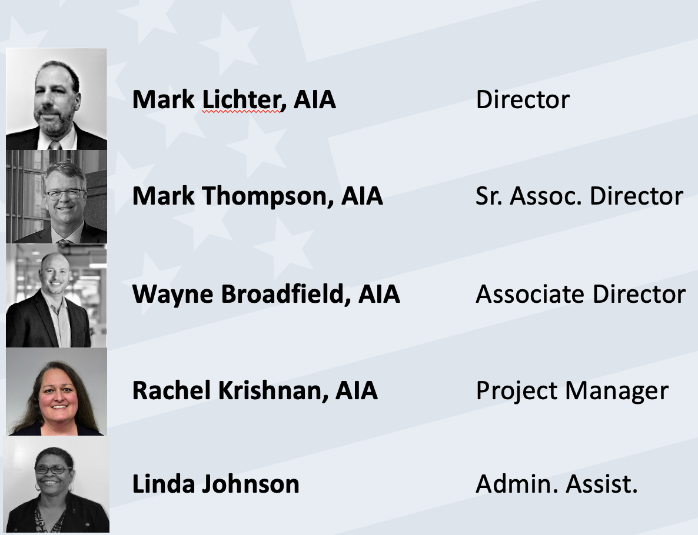
Meet the Architects

Slide 20
Mission Statement for Architecture:
We seek to promote an accessible, barrier free environment for all veterans and people with disabilities.
Access to public building and structures should be a fundamental right – and requires architectural design that makes public and private buildings, structures, entrances and other facilities wheelchair accessible.

Slide 21
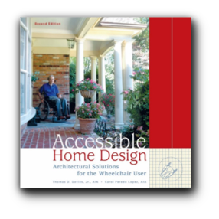
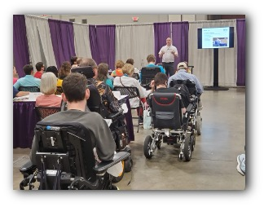
Education & Outreach
Public Seminars
Abilities Expos (Across the Country)
Publications
PN Magazine (Columns/ Cover Story)
‘Accessible Home Design’
Design Award Jury
Habitat for Humanity (‘22-’23.. Hopefully 2024)
CUA/ UVA/ VT/ UMD
Barrier-Free American Award
2022- Kennedy Center for Performing Arts
MO Solider Memorial/ Bob Villa/ VA Governor Mansion

Slide 22
Healthcare Architecture
VA System of Care
In-Person Site Visit/ Inspections
26 SCI/D Center Hubs/ 150+ ‘Spokes’
VA Design Directive 7501
Design Consultant
VA Design Standards
SCI/D Design Standards
Equipment (PG 18-12) & Space Criteria (PG 18-9) Requirements
Parking Design Manual

Slide 23
Accessible Design
Technical Assistance (pvaarchitecture@PVA.org)
Veteran
Developers
Non-Profits
Accessible Codes/ Standards
ADA (PVA Original crafters)
ANSI A117.1 Review Committee (2025 Ed.)
ABA/ USDFASS
US Access Board

Slide 24
Government Relations
Legislation and Advocacy teams
Work with other VSOs and Congress
Participate on the CCD Housing Task Force
Track relevant legislation
Gather feedback from PVA membership about housing issues

Slide 25
Legislation to Watch
H.R. 2818 / S. 3290 – Autonomy for Disabled Veterans Act
House: Reps. Bacon & Pappas
Senate: Cortez Masto & Boozman
Increases grant amount from $6,800 to $9,000
H.R. 4047 – Autonomy for All Disabled Veterans Act
House: Reps. Sorensen & Takano

Slide 26
Don’t Forget
For detailed questions always check in with your NSO
They are the experts
Different grants have different eligibility criteria
Issues that you encounter should be elevated!

Slide 27
Q&A
We are happy to answer any questions you may have

